Slide 1
iPremier (A): Denial of Service Attack – Case Study
By: Bhargav Sabbineni Ipsa Ojha Jeremiah Warren Kaustuv Dutta Swati M. Radia

Slide 2

History of iPremier
Founders: Blake Carleton and Rajiv Narayandas were classmates at Swarthmore College
In 1997, began operations in Seattle, California.
Business-to-Consumer (B2C) Company – online retailer mainly processing credit cards as payment
Products are mostly priced between fifty and a few hundred dollars
Hired Bob Turley as new Chief Information Officer in October 2008

Slide 3
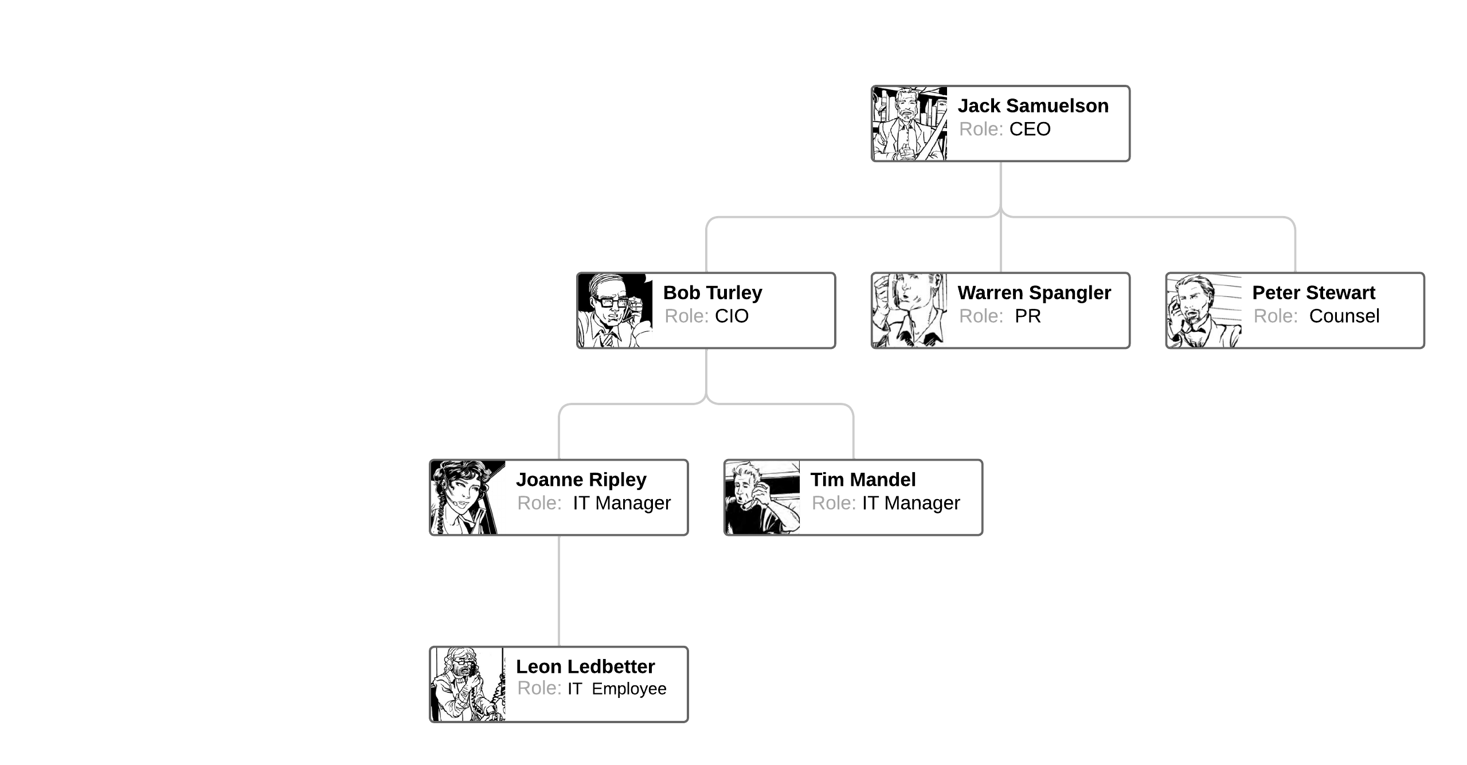
Organization Chart

Slide 4
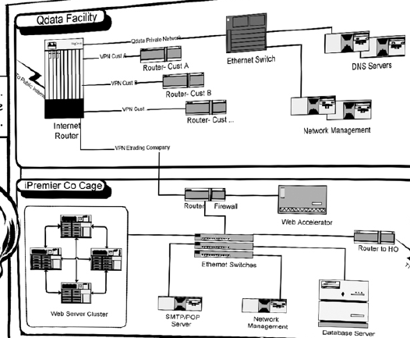
October 2008: Onboarding of Bob Turley (CIO)
Meets Leon Ledbetter, an IT employee, and his manager, Joanne Ripley
Leon and Joanne agree that Qdata, their IT service provider, is inadequate
They give the following reasons for why they don’t change providers:
Issue is not seen as a priority
A new facility would be expensive and cut into their profits
One of iPremier’s founders is friends with one of Qdata’s founders

Slide 5
If you were Bob, how concerned would you be with the information you just learned about iPremier? What are you most concerned about?

Slide 6
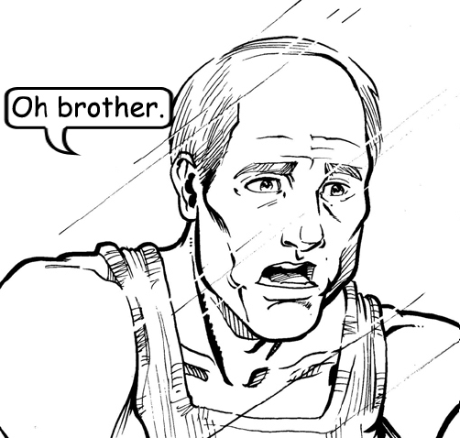
January 2009: Denial of Service Attack
Bob Turley, who is in New York on a business trip, receives a call from Leon Ledbetter at 4:30 A.M
Leon tells Bob that customers cannot access the company website
Support is also receiving an email that just says “ha” every second
Bob asks Leon if they had started emergency procedures, but Leon cannot locate a physical copy of the company’s emergency procedure plan

Slide 7
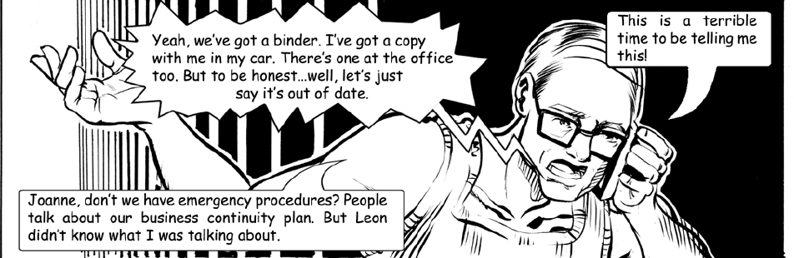
Bob’s Call With Joanne Ripley
After getting off the phone with Leon, Bob received a phone call from Joanne Ripley, who was on her way to Qdata’s data center
They consider pulling the plug, but opt to have Joanne restart the web server
Joanne informs Bob that the company’s business continuity plan is out of date and essentially useless

Slide 8
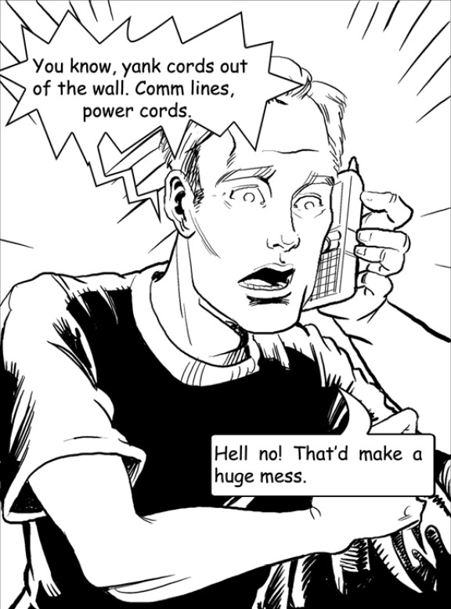
Bob’s Next Calls
Warren Spangler head of PR, talks about stock price taking a hit and asks whether police should be informed
Assures Bob that he'll take care of PR
Tim Mandel IT manager, gets a brief about the issue from Bob, and he suggests not to pull any cords as that will result in losing all logging data
Peter Stewart General Counsel, suggests that they shut off the systems until the issue is fixed as customer data is in danger
Joanne complains about not being let inside the Qdata data center and that Qdata is not monitoring the network

Slide 9
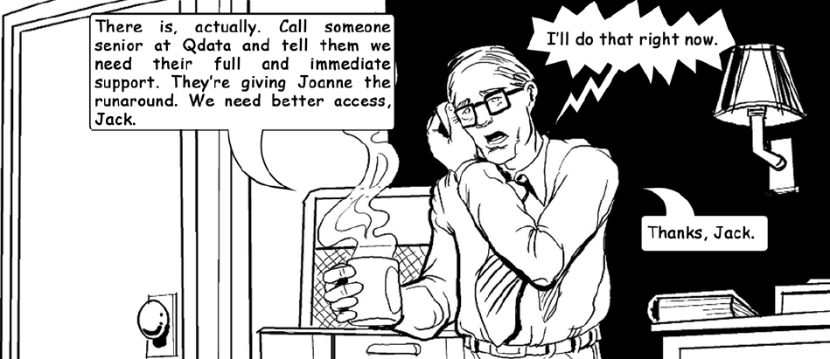
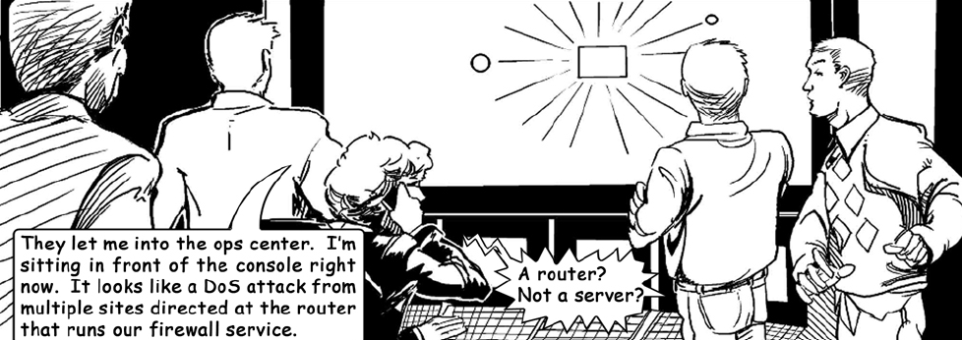
Calls with Joanne and Jack
Jack Samuelson calls Bob and asks if he could help in anyway
Bob asks him to call someone senior at Qdata to let Joanne into the facility
After Jack calls Qdata, Joanne was let into the Qdata’s operations center

Slide 10
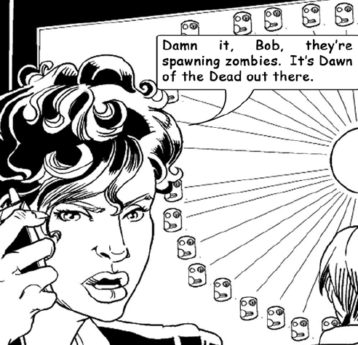
Joanne at Qdata
Joanne tells Bob that the attack is directed at the router that runs their firewall service
Joanne says they need a proper firewall, one that is much better than the current one
Joanne tries to shut off traffic from the 20-attacking addresses
10 new sites pop up to take their place
She tells Bob she will call him again when she has something else to report

Slide 11
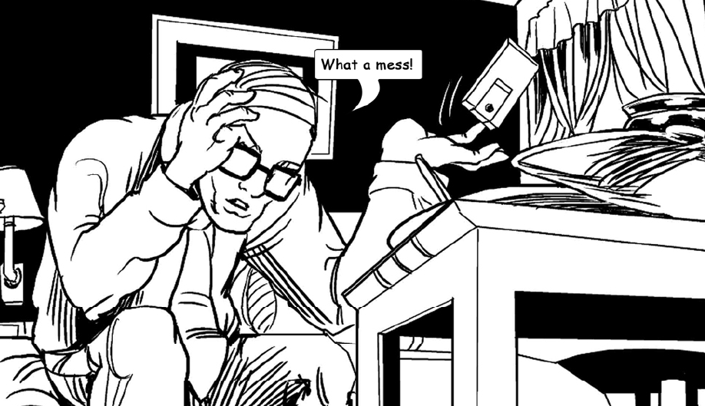
Attack is Over!
Joanne calls Bob again and informs him that the attack stopped all the sudden at 5:46 A.M.
They discuss whether the attack is the work of unsophisticated attackers (script kiddies), or if there was more to the attack like an intrusion
Bob asks Joanne to summarize her findings in a report
Now, Bob must decide what to tell the CEO about the attack and what to do next

Slide 12
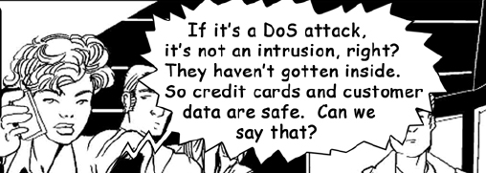
Do you think it's just a DoS attack, or is the DoS attack part of a much larger attack?
Notes:
Maybe: Do you think is just a DOS attack, or is the DOS attack part of a much larger attack?
Can sometimes DoS attack also mean intrusion or just services being down?

Slide 13
What do you think Joanne should include in her report to Bob? Can she make a conclusion about the nature of the attack? What should iPremier be worried about? What actions would you recommend?

Slide 14
Our Answer
Joanne should include in her reports about the occurrence of a DDoS attack, which was evident, but she also needs to include the possible occurrence of an intrusion as well and the negligence on the side of the service provider Qdata.
Based on the evidences present at that point of time, it's not possible to conclude that there was an intrusion, but Joanne must mention the occurrence of the DDoS attack with a possible intrusion.
iPremier needed to be worried about their chain of command, service provider Qdata, operational plans, disaster recovery, backups, business continuity plans, etc.
They also need to prioritize better security practices

Slide 15
Our Recommendations
iPremiere needs to incorporate the following actions:
1. Hire experienced security professionals and create a Disaster Management Team. They should also create an Incident Management Team
2. Security protocols should be introduced, and systems and devices should be updated on a regular basis inside the organization. A strong Password policy needs to be mandated.
3. Need to have a security and compliance training mandated for all the people, including the management inside the organization and to introduce RBAC for all entities.
4. Immediately upgrading to a better service provider and make sure that their data are backed up, monitored, audited, pen-tested and analyzed regularly
5. Protection against data leakage, corporate espionage and sabotage of sensitive information.

Slide 16
How well did the iPremier Company perform during the 75-minute attack? If you were Bob Turley, what might you have done differently during the attack?

Slide 17
Our Answer
Considering the early hour and lack of business continuity plan, the employees at iPremier responded as well as could be expected to the DDos attack on the morning of January 12, 2009
Both Leon and Joanne were proactive about resolving the issue.
Executives Warren Spangler and Peter Stewart did little to help guide the company through the attack
We approve of Bob’s performance overall, but identified steps he should have taken that would have improved his organization’s response to the attack:
Conference call with team
Prioritize PII data
Documented his actions
Finally, should Bob have pulled the plug?

Slide 18
The iPremier Company CEO, Jack Samuelson, had already expressed to Bob Turley his concern that the company might eventually suffer from a “deficit in operating procedures.” Were the company’s operating procedures deficient in responding to this attack? What additional procedures might have been in place to better handle the attack?

Slide 19
iPremier's
Current
Operating Procedure
Emergency procedure plan - They had binder, which wasn't tested recently
Chain of command – IT personnel directly contacted senior management without having a proper understanding of the situation.
Escalation with Qdata – There was no proper point of contact at Qdata and the issue wasn't escalated with until it was too late.
Access control at Qdata – IT Manager wasn't allowed inside until someone senior got involved.
Nature of the attack – unsure if it was a DoS attack or if there was an intrusion.

Slide 20
Additional Procedures
iPremier
Needed
Conference Call - CTO should have held a conference call with key IT staff, Qdata personnel, and legal team
Critical Services – Identify and prioritize critical services and application that hold sensitive PII data
System Logs – Investigate system logs and configuration to better understand the issue
Contact law Enforcement
Temporarily Unavailable Page – set a webpage in case the attack lasts longer

Slide 21
Risk Analysis
Assests
PII Data ( like credit card details, SSN, etc.) Company Reputation Customer Relationship Stocks Internal IT infrastructure - Web servers, routers, switches, firewall
Vulnerabilities
Qdata Out-of-date business continuity plan Inexperienced team Weak firewall No proper line of control
Threats
DDOS – targeting router Intrusion Data Breach Ransomware Insider Threat
Controls
Upgrading firewall 24/7 monitoring Upgrade server capacity Access control at Qdata Better business continuity and disaster recovery plan Conduct internal audit and regular audits

Slide 22


Quantitative Risk Analysis
Threats | Probability (0-100%) | Impact (1-5) | Risk Rank | Decision
DDOS | 85% | 5 | 1 | Risk Mitigation/Transfer
Ransomware | 70% | 4 | 2 | Risk Transfer
Malware | 40% | 3 | 4 | Risk Transfer
Insider Threat | 20% | 2 | 3 | Risk Mitigation

Slide 23
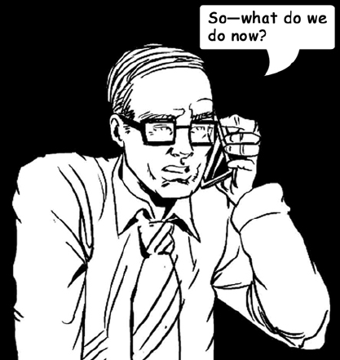
Now that the attack has ended, what can the iPremier Company do to prepare for another such attack?
Most important: decide what to do with Qdata
Update security plans and business continuity plan
Create backups
Establish proper line of command in the case of emergencies
Complete a thorough investigation – conduct an internal audit, hire external auditors, and establish a plan for regular audits.
Ensure management has basic IT knowledge
Create an accountable legal team
Practice emergency procedures
Basic Security and Compliance training for all employees
Do not use company resources to play online video games

Slide 24
What to do about Qdata?
Three Approaches
Replace Qdata with another service provider
Stay with Qdata, but upgrade the security
Develop iPremier’s internal IT team (add security experts)
Notes:
Notes:
Replace Qdata. Contract a new IT service company for proper security services, eventually decreases the risk of DDOS and increases the trust of customer
If Qdata can't be replaced, stay with Qdata but require upgrade to advanced technology which gives less expenditure to Ipremier, saves time by not replacing with a new provider
Develop Internal IT, by developing one's own security and facilities for storing data, upgrade and maintain emergency procedures which gives full control to their IT system and lower administrator cost.

